Slide 1

NỘI QUY TIẾT HỌC
GIƠ TAY
KHI CÓ Ý KIẾN
NGỒI ĐÚNG
TƯ THẾ
ÂM LƯỢNG
MỨC 0
4
3
90
2
1

Slide 2
01
Siêu tài năng
Hình thức: Hoạt động cá nhân

Slide 3
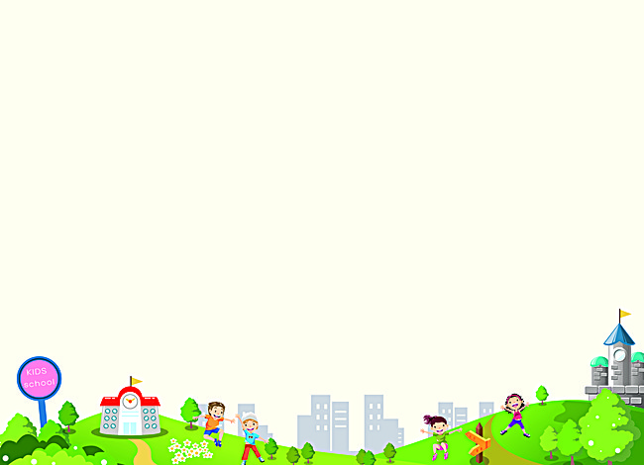


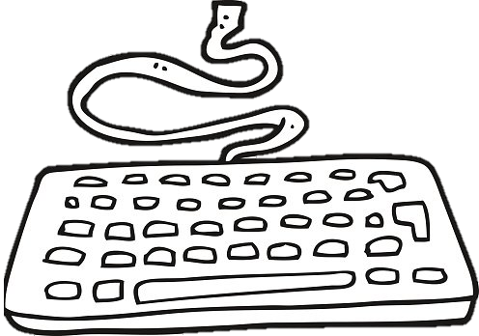
Xin Chào Các Bạn
Tớ đố các bạn lập trình là gì đấy?
Học lập trình có khó không nhỉ?
Notes:
Lập trình là việc một người sử dụng các ngôn ngữ lập trình để tạo ra một phần mềm máy tính, trò chơi, trang web, ứng dụng,..

Slide 4

Chèn SmartArt
TIN HỌC 2
CHỦ ĐỀ: LÀM QUEN VỚI VĂN BẢN
Đặng Phương Thúy

Slide 5
MỤC TIÊU BÀI HỌC
1
2
Trình bày được
thao tác chèn SmartArt vào
văn bản
Vận dụng được
thao tác chèn SmartArt vào bài thực hành

Slide 6
02
AI LÀ CHUYÊN GIA
Hình thức: Thảo luận nhóm, vấn đáp

Slide 7



AI LÀ CHUYÊN GIA?
Làm thế nào chèn SmartArt vào văn bản?
(Gợi ý: Dùng thẻ Insert)
Hình thức: Nhóm 2
Máy lẻ mở Word
Thời gian thảo luận: 2 phút
Thời gian trình bày trước lớp: 1 phút

Slide 8


Slide 9
CÁCH CHÈN SMARTART
Insert
SmartArt
Chọn SmartArt
Nhập nội dung

Slide 10
03
EM LÀ CHUYÊN GIA
Hình thức: Cá nhân

Slide 11
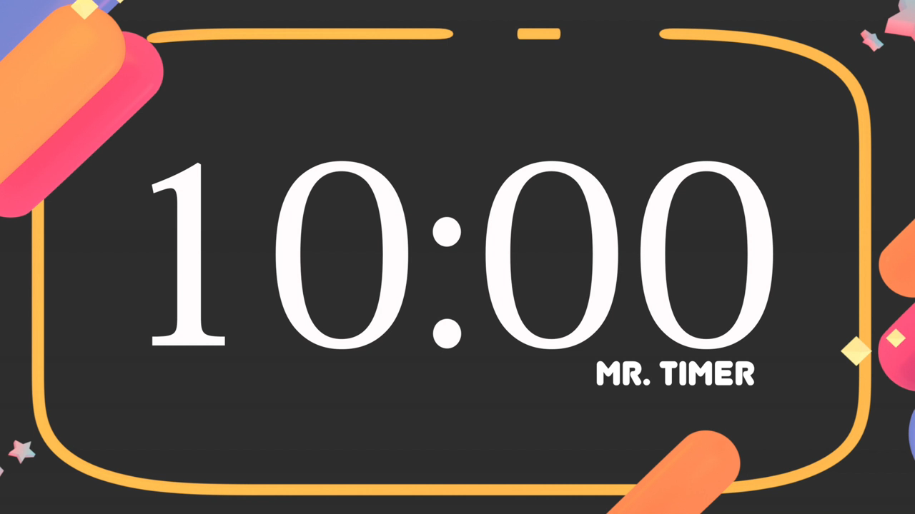


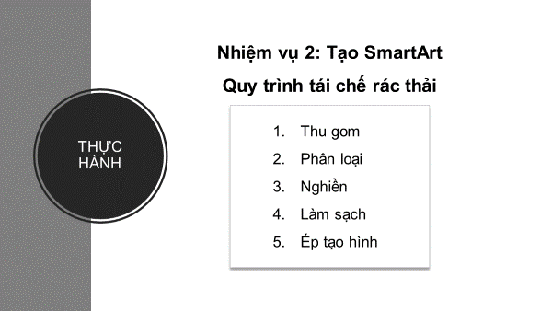


THỰC HÀNH
1. Mở Word
2. Thực hiện chèn SmartArt phù hợp với “Quy trình tái chế rác thải” bên
3. Lưu bài: Lớp_Tên_Tuần 22
4. Chèn hình ảnh minh họa phù hợp
5. Thay đổi màu/kích cỡ cho SmartArt

Slide 12
MỤC TIÊU BÀI HỌC
1
2
Trình bày được
thao tác chèn SmartArt vào
văn bản
Vận dụng
thao tác chèn SmartArt vào bài thực hành

Slide 13

GÓC CHIA SẺ
01 điều con đã học được?
01 điều con cần làm tốt hơn?

Slide 14



Con đánh giá tiết học
hôm nay như thế nào?

Slide 15
#4. Capitalize places including addresses, cities, states, countries, and continents
Capitalize abbreviations of these places too!
I live on Main Street in Houston, Texas. Texas is a state in the United States of America
I live on Main Street in Houston, Texas. Texas is a state in the United States of America
Here you could write your exercise

Slide 16
#5. Capitalize the titles of written or performed works like books or movies
Titles of artistic works also get capitalized!
Cloudy with a Chance of Meatballs is a book that was later made into a movie
Cloudy with a Chance of Meatballs is a book that was later made into a movie
Here you could write your exercise

Slide 17
#6. Many words only get capitalized depending on how they are in the sentence
Capitalize this... | Only if...
north, south, east, west | ...you use it as a specific place and not a direction
mom, dad, aunt, grandma, etc. | ...you can replace the word with the relative’s name and still makes sense
mountain, desert, river, ocean, etc. | ...it is a part of its actual name, such as Mojave Desert
earth | ...you’re talking about the planet Earth
college, school, library, university, etc. | ...you use it with the actual name, such as Hassler Elementary School

Slide 18
02
Comma Rules
You could enter a subtitle here if you need it

Slide 19
Awesome words

Slide 20
#1. Use a comma before a conjunction when combining two complete sentences
I need to go to the grocery, and my sister needs to go to the library
{I need to go to the grocery}, {and my sister needs to go to the library}
Here you could write your exercise

Slide 21
#2. Use commas to separate three or more words or phrases
I need to finish my homework, take out the dog, and help Mom with the dishes
{I need to finish my homework}, {take out the dog}, {and help Mom with the dishes}
Here you could write your exercise

Slide 22
#3. In dialog, use a comma to separate the narrator from the speaker
“I want to study medicine when i grow up,” Maria declared.
Derek responded, “You do?”
“{I want to study medicine when i grow up},” {Maria declared.}
{Derek responded}, “{You do?}”
Here you could write your exercise

Slide 23
#4. Use a comma (or two) when you directly mention a person
Julia, please hand me that box of crayons. Will You, John, hand me the pencils?
{Julia}, please hand me that box of crayons.
Will You, {John}, hand me the pencils?
Here you could write your exercise

Slide 24
#5. Use a comma to separate an introductory phrase from the sentence
After the big game, the baseball team celebrated their win
{After the big game}, {the baseball team celebrated their win}
Here you could write your exercise

Slide 25
#6. Use a comma after a transition word or phrase
Finally, mix the chocolate syrup and the milk. After you’re done, enjoy your tasty drink
{Finally}, mix the chocolate syrup and the milk. {After you’re done}, enjoy your tasty drink
Here you could write your exercise

Slide 26
04
Dialogue Rules Reference
You could enter a subtitle here if you need it

Slide 27
Dialogue Rules Reference
#1. Quotation Marks
#2. Commas in quotation marks
Mercury is the closest planet to the Sun
Venus has a beautiful name, but it’s hot
#3. ? and ! in Quotation Marks
#4. Examples
Despite being red, Mars is a cold place
It’s the farthest planet from the Sun

Slide 28
#1. Use quotation marks around the words that someone is actually saying
“This is so much fun!,” said Jenna
“This is so much fun!,” said Jenna
Here you could write your exercise

Slide 29
#2. Commas are used to separate the speaker from the narrator
“This is my favorite toy,” said Sally. Charles responded, “I prefer my toy car!”
“This is my favorite toy,” said Sally.
Charles responded, “It’s so cute!”
Here you could write your exercise

Slide 30
#3. You can replace a comma with a question mark or an exclamation point
“What are you doing?” asked Mom. Jackson looked up, “having fun!” he said
“What are you doing?” asked Mom.
Jackson looked up, “having fun!” he said
Here you could write your exercise

Slide 31
#4. Examples
N = Narrator S= Speaker
Structure | Example
S | “I like the summer.”
S - N | “I like the summer,” said Maria.
N - S | Maria said, “I like the summer.”
S - N - S | I really like summer,” Maria said and then added, “because it’s time to swim!”

Slide 32
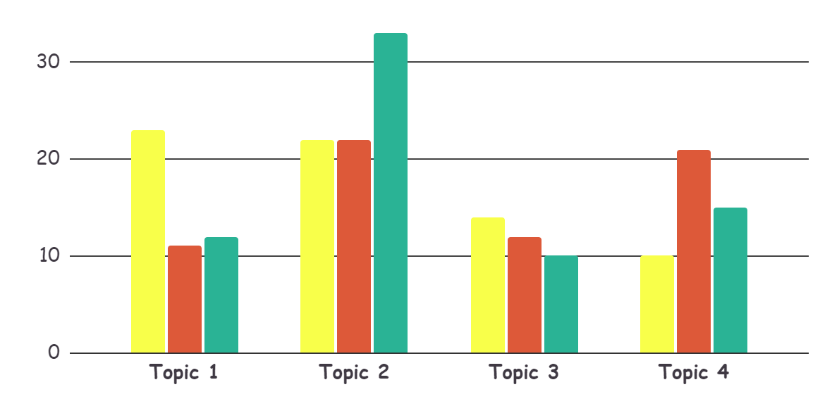
This is a graph
30% - Venus
Venus has a
beautiful name
20% - Mercury
It’s the closest planet to the Sun
50% - Mars
Despite being red, Mars is a cold place
To modify this graph, click on it, follow the link, change the data and paste the resulting graph here, replacing this one

Slide 33
These are percentages
Mercury
Saturn
Jupiter
60%
75%
25%
Mercury is the smallest planet of them all
Saturn is composed of hydrogen and helium
Jupiter is the biggest planet of them all

Slide 34
This is an infographic
60%
15%
Mars
Venus
Despite being red, Mars is a cold place
Venus has a beautiful name, but it’s hot
15%
Mercury
Mercury is the closest planet to the Sun

Slide 35
This is a map
Venus
Venus has a
beautiful name
Mercury
It’s the closest planet to the Sun
Mars
Despite being red, Mars is a cold place

Slide 36
A timeline always works well
day 2
day 4
day 1
day 3
Venus is terribly hot and has high temperatures
Jupiter is the biggest planet of them all
Mercury is the smallest planet of them all
Saturn is composed of hydrogen and helium

Slide 37
4,498,300
Big numbers catch your audience’s attention

Slide 38
333,000.00
24h 37m 23s
386,000 km
earths is the Sun’s mass
is Jupiter’s rotation period
is the distance between Earth and the Moon

Slide 39
Our team
Jenna Doe
John Patterson
Helena White
You can replace the image on the screen with your own
You can replace the image on the screen with your own
You can replace the image on the screen with your own

Slide 40

Desktop Software
You can replace the image on the screen with your own work. Just delete this one, add yours and center it properly

Slide 41

Tablet app
You can replace the image on the screen with your own work. Just delete this one, add yours and center it properly

Slide 42
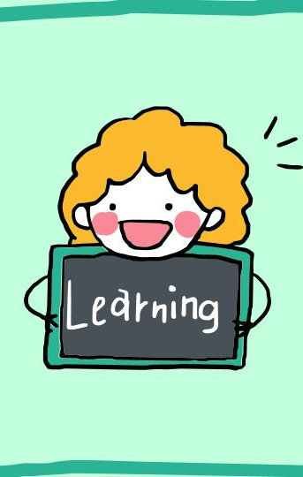
Mobile web
You can replace the image on the screen with your own work. Just delete this one, add yours and center it properly

Slide 43
Thanks!
Do you have any questions?
youremail@freepik.com
+91 620 421 838
yourcompany.com
Please keep this slide for attribution

Slide 44
Alternative resources

